Slide 1


ART GALLERY EXPO
BATCH NO - 71
NAME - ROLL NO
19H51A05J4 - A. Vijay Vardhan Reddy
19H51A05K1 - Ch. Usha
19H51A05K2 - G. Manasa
19H51A05K3 - G.Ganendhar
MINI PROJECT - 1
Under the supervision of:
G.VAMSHI KRISHNA

Slide 2
LIST OF CONTENTS
Abstract
Problem Statement
Introduction
Literature Survey
Proposed Solution
Software & Hardware Requirements
Architecture
Uml diagram
Conclusion
References

Slide 3
ABSTRACT
Art Gallery expo is a website where artists can show up their art work and customers can buy the art from art gallery. Now a days people are not having sufficient time to go to the art gallery and view the paintings, some may not have the chance to study the art compositions in that place. So this art gallery will give a chance to those who are keen at arts. By this website, end-users can explore all kind of art works. The arts done by the artists are thus exposed in the portal. The website is designed with a friendly user-interface and it also provides details of the art works such as table of content (details of the art). Art Gallery is a time and money saving web site concept.

Slide 4
PROBLEM STATEMENT
For artists it is hard to approach the customers and monitor the art gallery details. Because of busy schedule of the people, they don’t have enough time to visit the art gallery . It is also hard to explore all types of arts within less time.

Slide 5

INTRODUCTION ABOUT THE PROJECT
The main objective of art gallery is, it has multiple roles, both visible and invisible: to support the artists, promoting their arts, and selling the works; and to provide services such as financial management, in order to help their artists.

Slide 6

SCOPE OF PROJECT
This project is meant for the customers who are interested in art galleries. The requirement changes to the project can be made based on the customer needs, change in technology etc.
Trading things online is quite easy and convenient for all the parties involved. Internet based services are fast emerging and many people are getting comfortable with purchasing stuff online. Online art galleries are one such trend.

Slide 7
EXISTING SYSTEM
Customer can also register online and they can browse art works that are arranged in different categories. Each Customer can create their own gallery to see his favorite art works without much difficult.
Each user has the right to purchase an art work using different modes of payment .
Art is thus delievered to the customer after the payment .

Slide 8
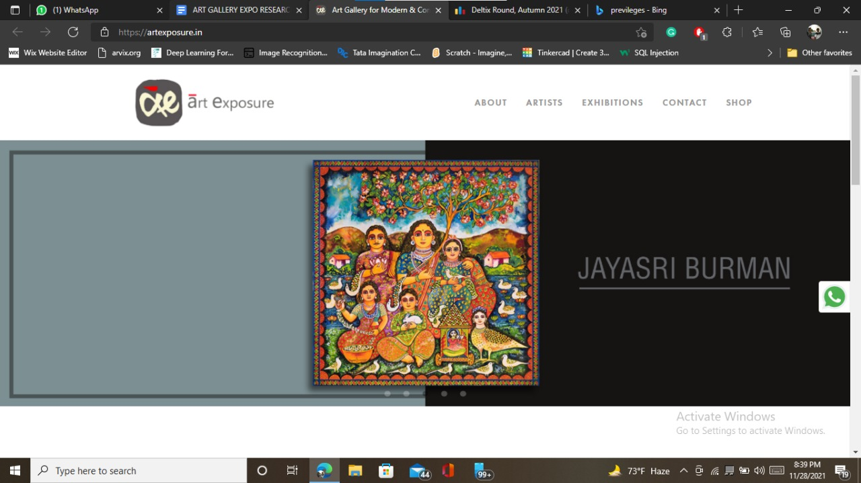
https://artexposure.in

Slide 9

LIMITATIONS OF EXISTING SYSTEMS
We could not get the composition of the art.
Not providing data about the art in exact format.
Allowing the pictures of the arts for downloading.

Slide 10
PROPOSED SYSTEM
ART GALLERY EXPO is a website. It is very helpful for the art lovers . This website helps the end-users to get their arts and paintings based on their interests. Art Gallery brings an opportunity to view online arts at our Art Gallery Expo, we bring details of all arts done by many different artist. The Art Gallery Expo is updated periodically, so the user can view and buy the latest collection of contemporary art online from anywhere. User can also view and buy the latest contemporary art collection available at our portal.The end user can get the contact details of the artist so that they can reach the artist directly.The portal includes the the cost of the art.

Slide 11
Software & Hardware Requirements
SOFTWARE
Operating system : Windows 10
DBMS : MongoDB.
Compiler : Visual studio code
Front-end tools : HTML,CSS,Bootstrap,EJS.
Back-end tools : Node.Js,Express.Js.
HARDWARE
Platform : windows and later versions.
RAM : 8GB
System configuration : 32GB

Slide 12
ARCHITECTURE
Art Gallery Expo
HOME
About us
Sign up
Login
View All Posts
Post
About us
Contact us

Slide 13
UML DIAGRAMS
MEMBER
login
ART GALLERY EXPO
login
ARTIST
register
register
Get Details
Get Details

Slide 14
E-R DIAGRAM
username
Name
customer
amount
address
Likes_
artist
Contact Number
Name
Address
Artist
Paint
UPI_ID
type
Art work
price
title

Slide 15
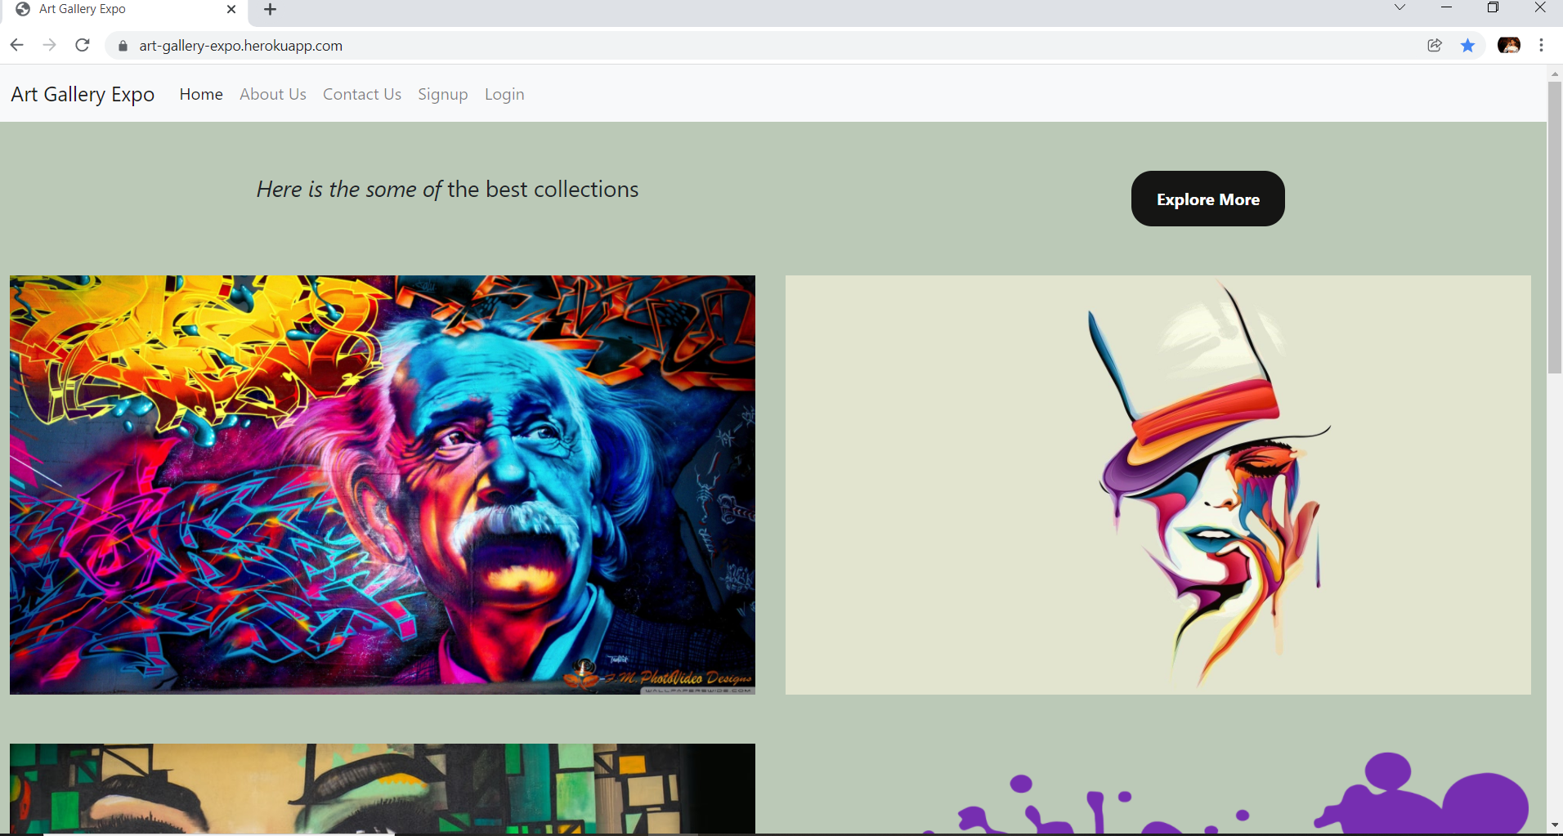

Slide 16
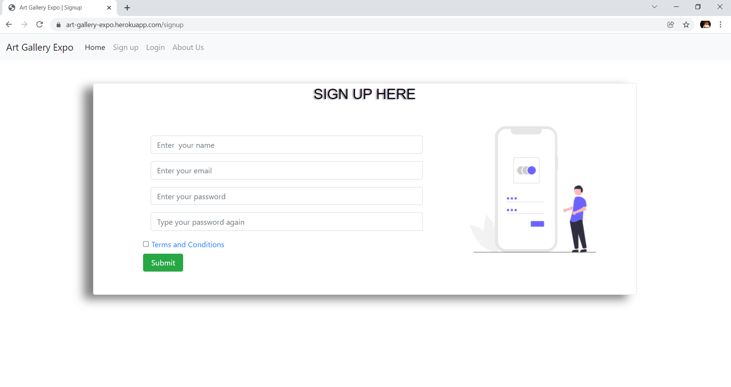
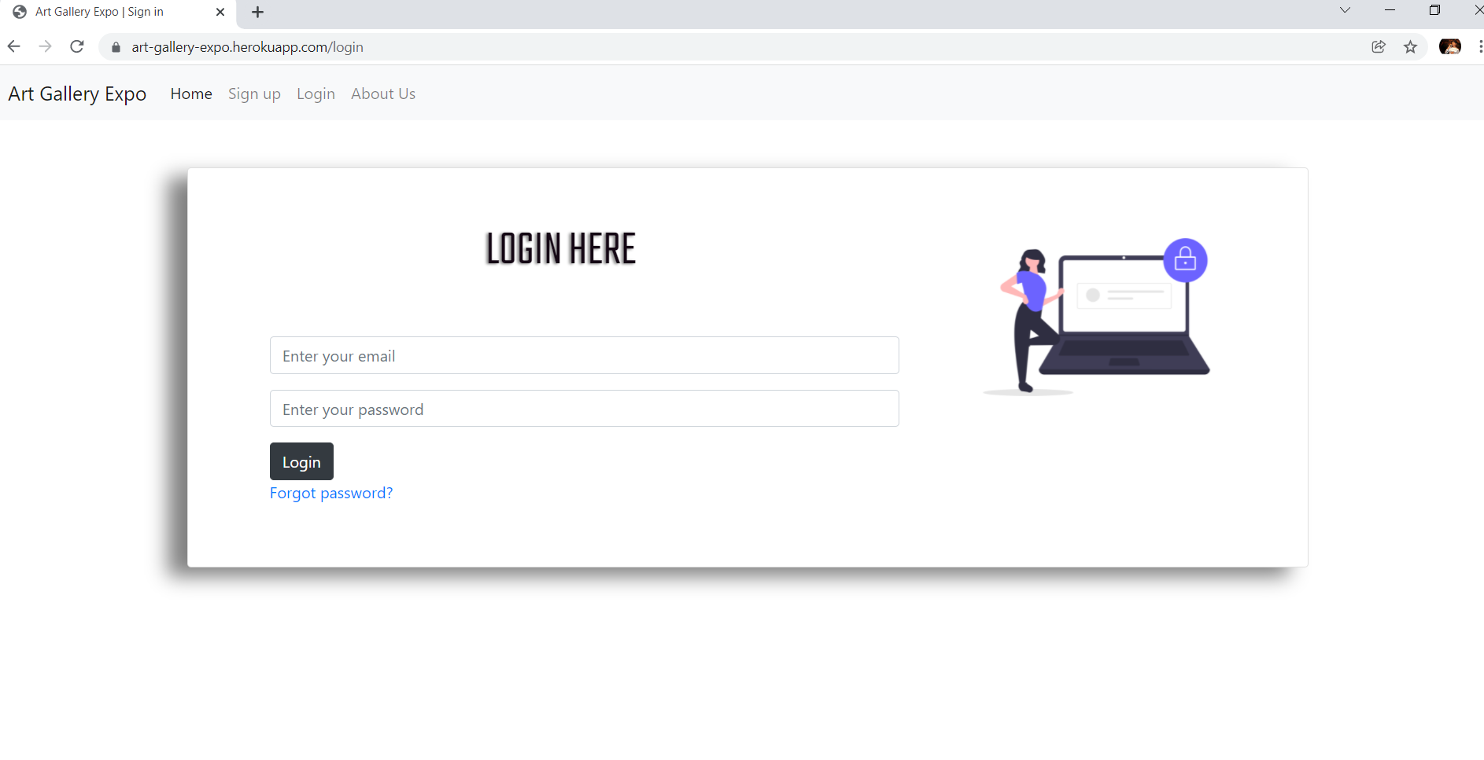

Slide 17
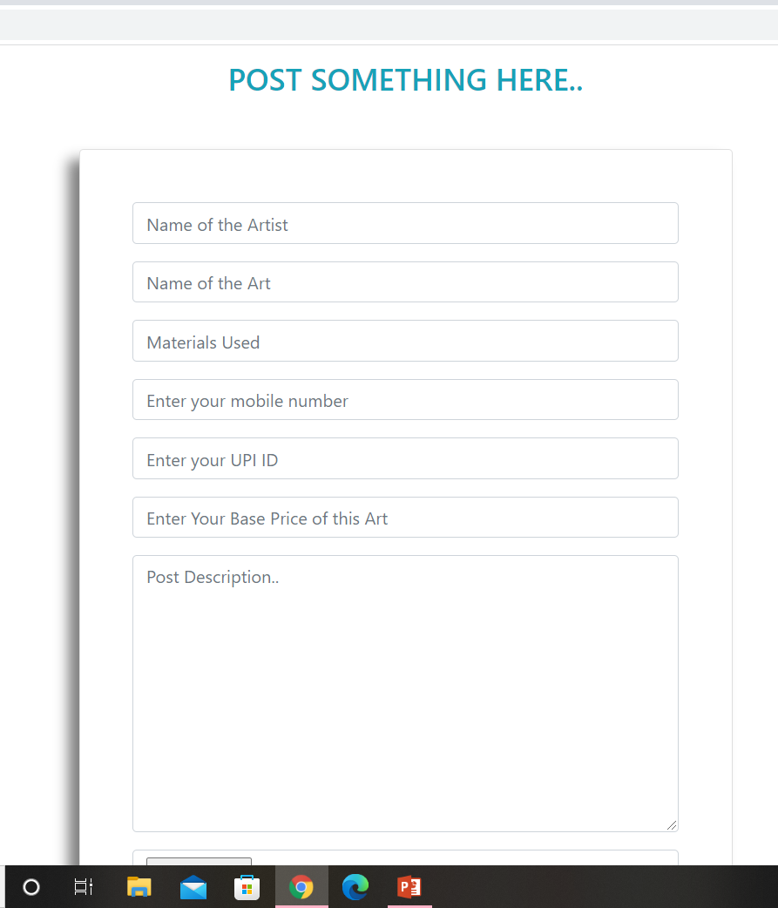
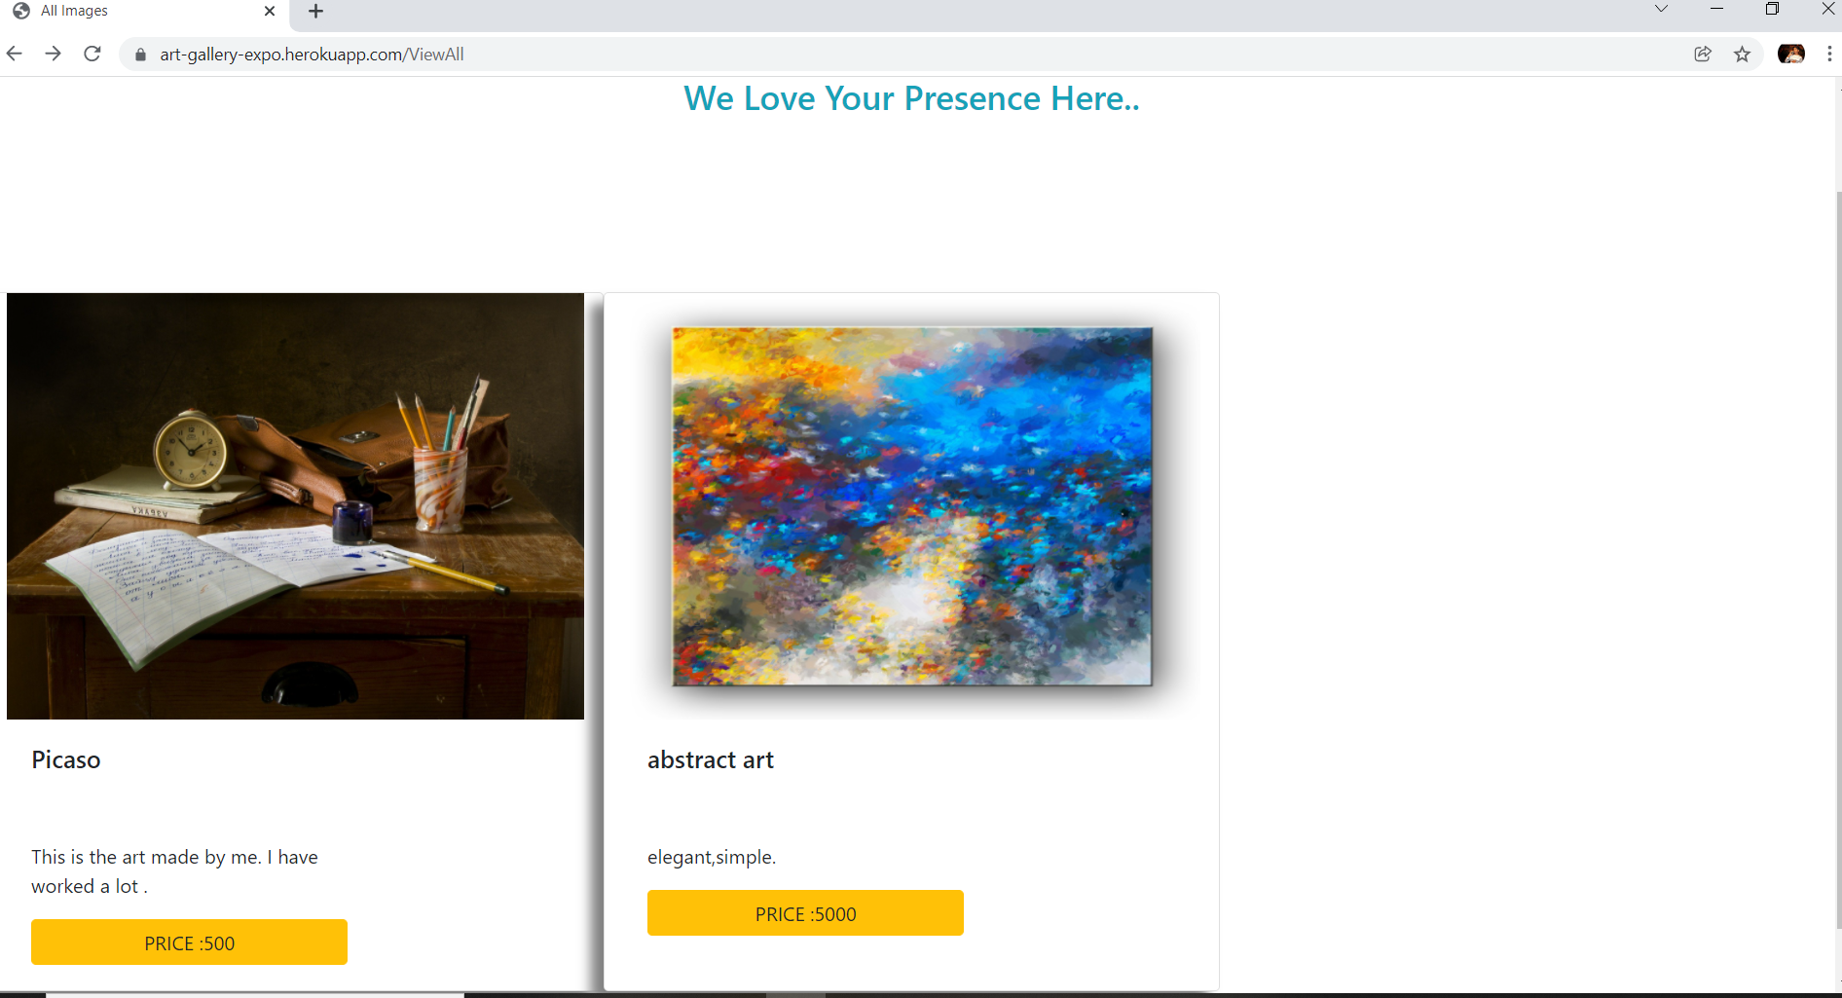

Slide 18
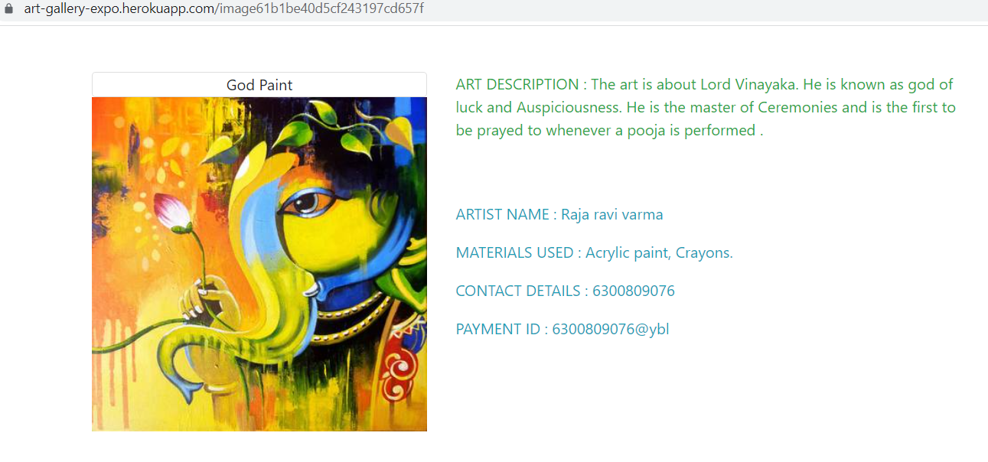

Slide 19
CONCLUSION
As people are busy in their own schedules and they are unable to visit the gallery so as to maintain a communication between the artist and the customer ,Online Art Gallery Expo acts a the medium.
The main aim of the online art gallery expo is to decrease the stress and letting them to enjoy the arts through online mode , which also reduces their travel stress.
The customers can order any of the art work , and can also contact the artist for any further communication.

Slide 20
REFERENCES
https://www.contemporaryartgalleryonline.gallery/
https://colorlib.com/wp/art-gallery-websites/
https://www.slideshare.net/onalkothari/literature-study-on-art-gallery

Slide 21
THANK YOU

